Slide 1
Week 1
Pressure units
Rank these in order of the biggest unit to the smallest unit (like, 1 hour > 1 minute):
bar, pascal, torr, atm

Slide 2
Week 1
The E-format convention
Write 1.38 x 10⁻²³ using the E-format convention

Slide 3
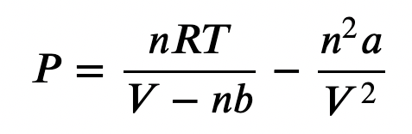
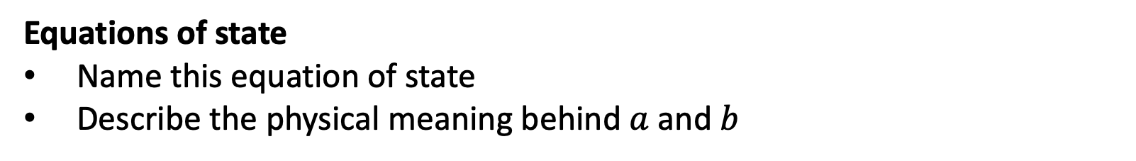
Week 1
Equations of state
Name this equation of state
Describe the physical meaning behind $a$ and $b$

Slide 4
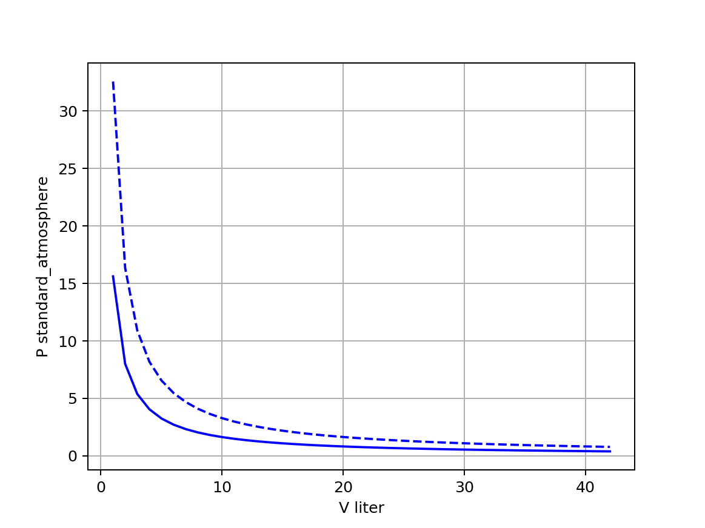
Week 2
Boyle isotherms
Which line is the hotter isotherm? What’s your reasoning?

Slide 5
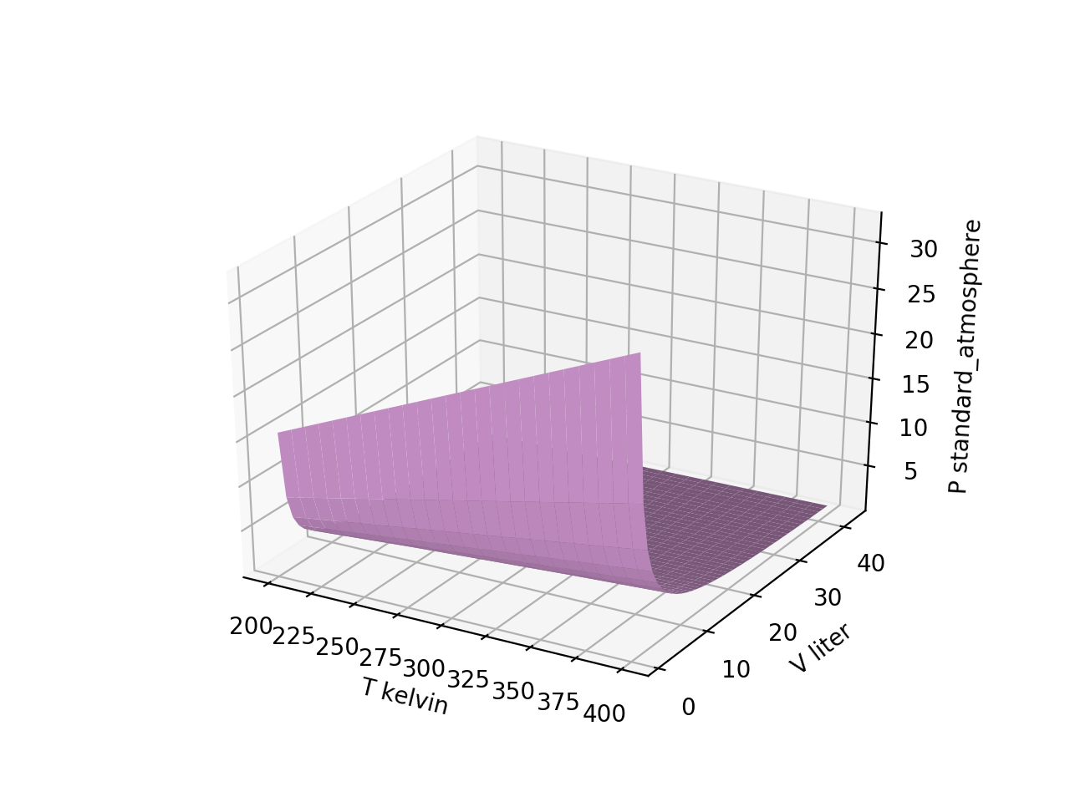
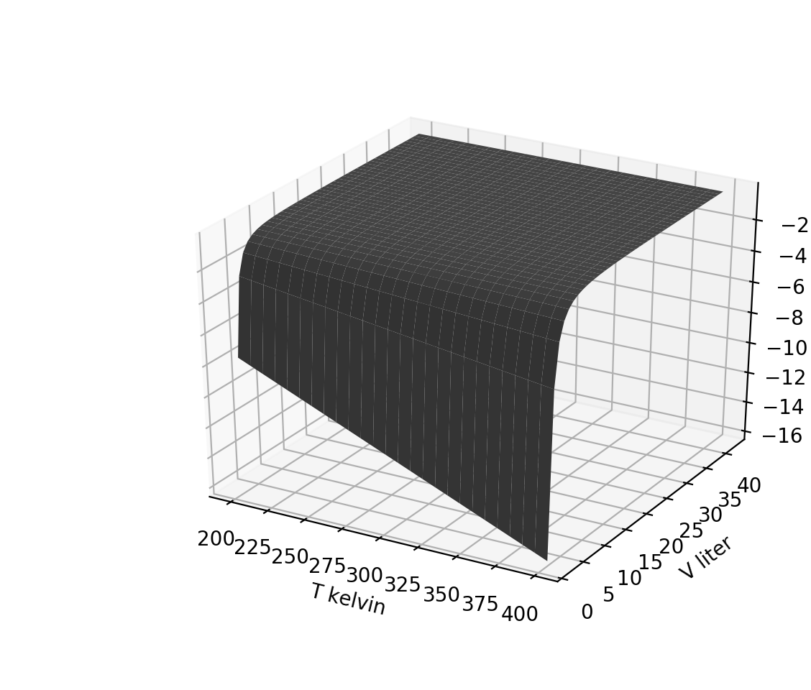

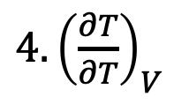
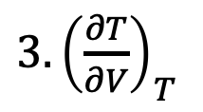
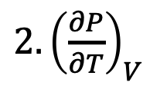
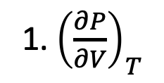
Week 2
Visualizing derivative thermodynamic surfaces
Which thermodynamic surface is the one on the right?
1. ${\left(\frac{∂P}{∂V}\right)}_{T}$
$$P(T,V)$$
$2. {\left(\frac{∂P}{∂T}\right)}_{V}$
${3. \left(\frac{∂T}{∂V}\right)}_{T}$
${4. \left(\frac{∂T}{∂T}\right)}_{V}$

Slide 6
Week 2
Slicing
Assuming grids have been organized in the way we’ve been doing it, which might give you one of the curves shown on the right? (The number “3” is kind of arbitrary.)
$$P(T,V)$$
Pgrid[:,3]
Pgrid[3,:]
Pgrid[3,3]
Pgrid[:,:]

Slide 7
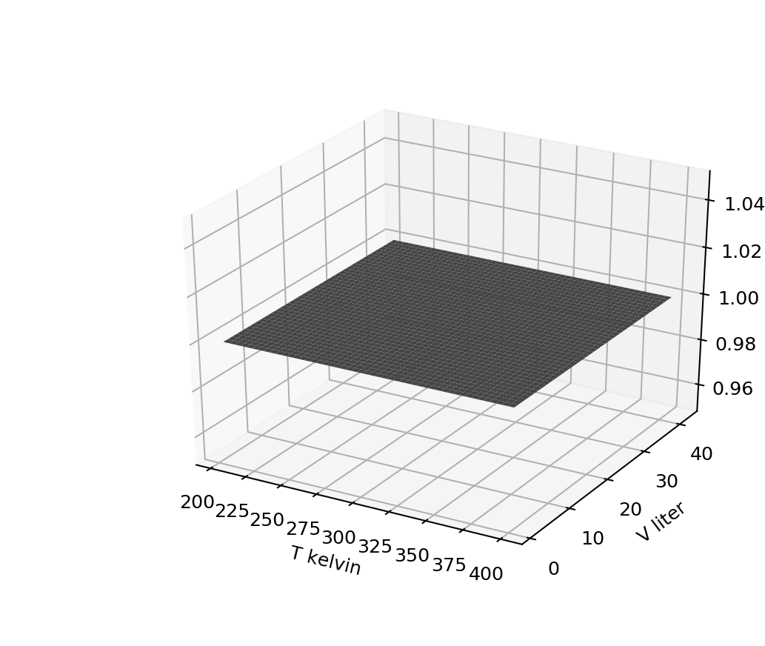
Week 2
No-brainers
Which surface could we be looking at now?
1. ${\left(\frac{∂P}{∂V}\right)}_{T}$
$2. {\left(\frac{∂P}{∂T}\right)}_{V}$
${3. \left(\frac{∂T}{∂V}\right)}_{T}$
${4. \left(\frac{∂T}{∂T}\right)}_{V}$

Slide 8
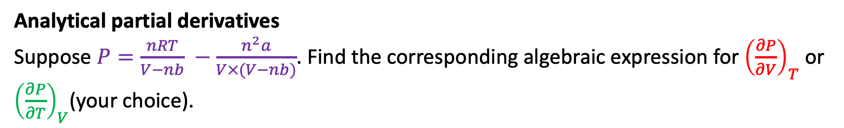
Week 2
Analytical partial derivatives
Suppose $P=\frac{nRT}{V−nb} −\frac{n^{2}a}{V×(V−nb)}$. Find the corresponding algebraic expression for ${\left(\frac{∂P}{∂V}\right)}_{T}$ or ${\left(\frac{∂P}{∂T}\right)}_{V}$(your choice).

Slide 9
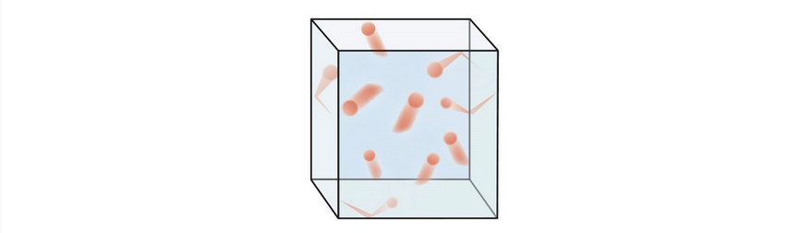
Week 3
The kinetic-molecular theory of gases
Describe a few key assumptions of the kinetic-molecular theory of gases and/or the theory behind the ideal gas law.

Slide 10

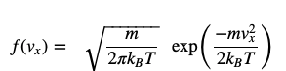
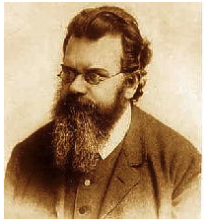
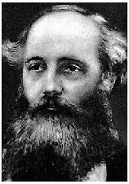
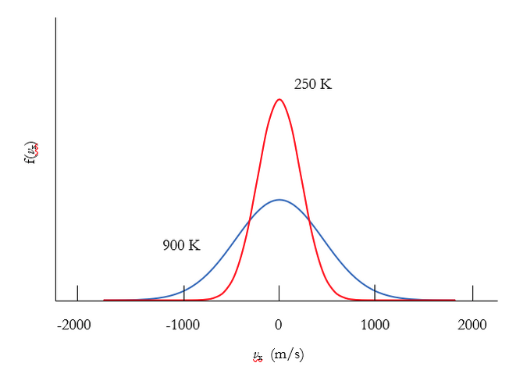
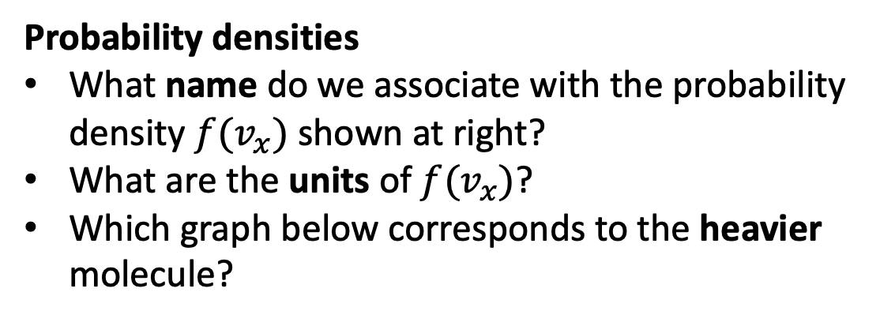
Week 3
Probability densities
What name do we associate with the probability density $f(v_{x})$ shown at right?
What are the units of $f(v_{x})$?
Which graph below corresponds to the heavier molecule?

Slide 11
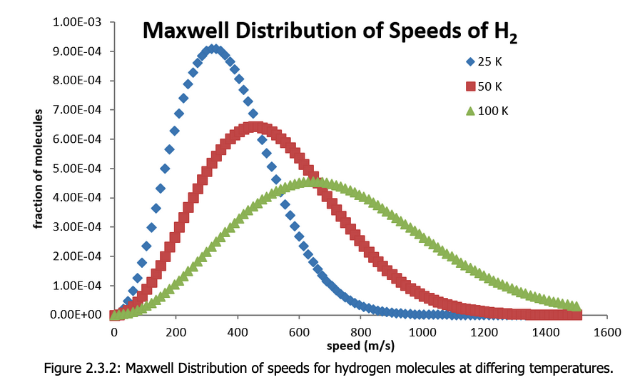

Week 3
Probabilities from probability densities
What’s the probability (as a fraction, and also in %) of finding an H₂ molecule with speed between 390 m/s and 400 m/s, if its temperature is 50 K?
$f_{M}\left(v\right)$ $(\frac{s}{m})$

Slide 12
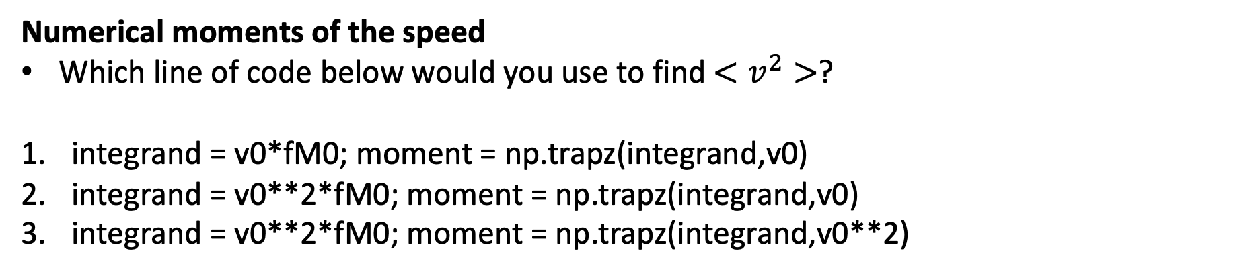

Week 3
$$f_{M}=N_{M}v^{2}\exp\left(−Dv^{2}\right)$$
Numerical moments of the speed
Which line of code below would you use to find $<v^{2}>$?
integrand = v0*fM0; moment = np.trapz(integrand,v0)
integrand = v0**2*fM0; moment = np.trapz(integrand,v0)
integrand = v0**2*fM0; moment = np.trapz(integrand,v0**2)

Slide 13
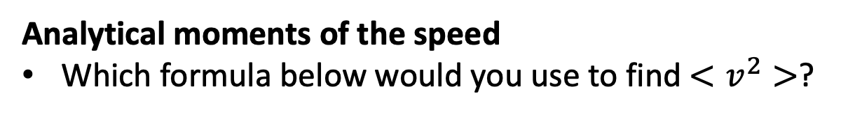

Week 3
$$f_{M}=N_{M}v^{2}\exp\left(−Dv^{2}\right)$$
Analytical moments of the speed
Which formula below would you use to find $<v^{2}>$?

Slide 14
Week 4
Equipartition
Describe what the equipartition theorem is about, with an example

Slide 15
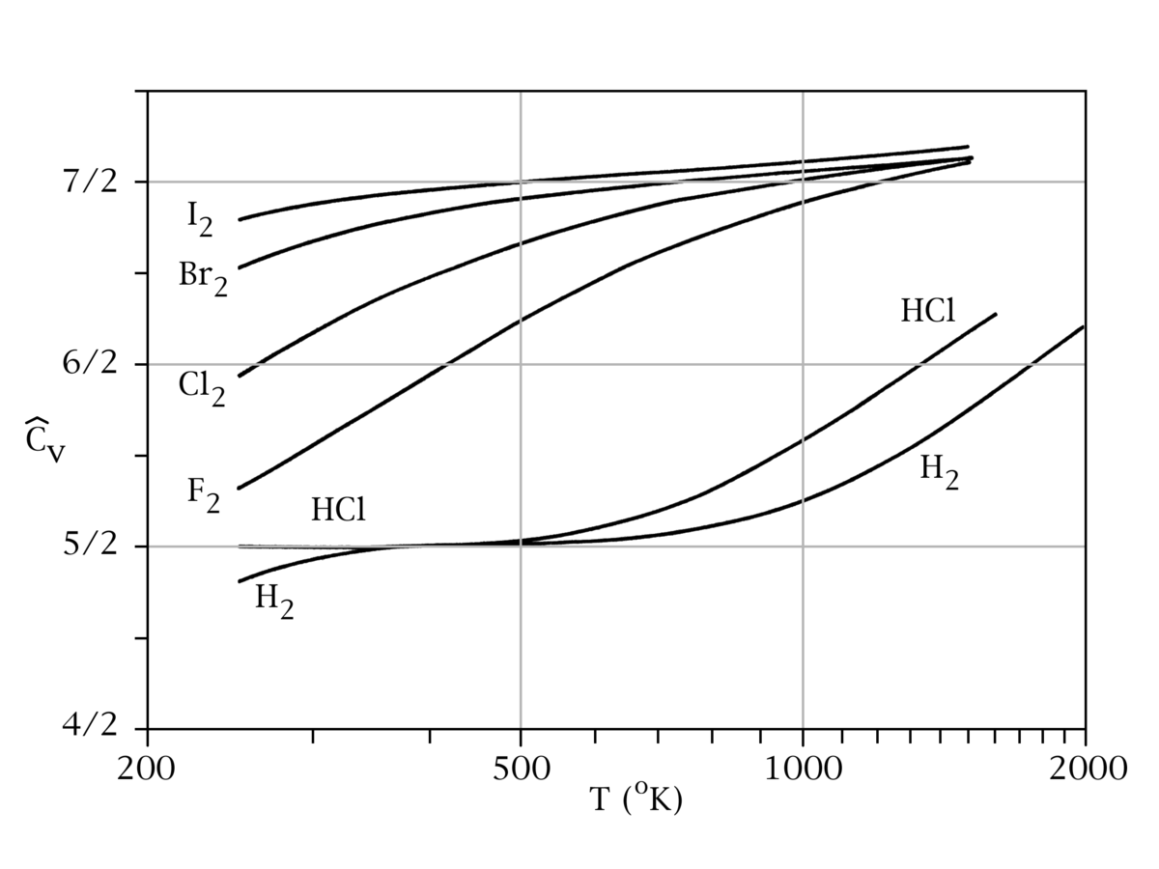
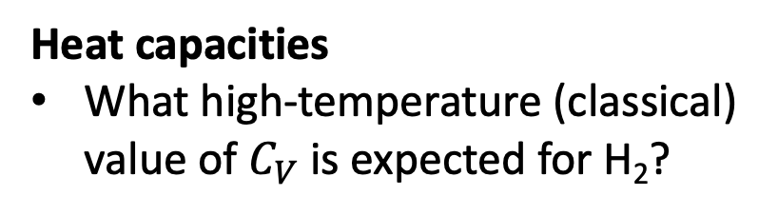

Week 4
Heat capacities
What high-temperature (classical) value of $C_{V}$is expected for H₂?
$$C_{V}$$

Slide 16
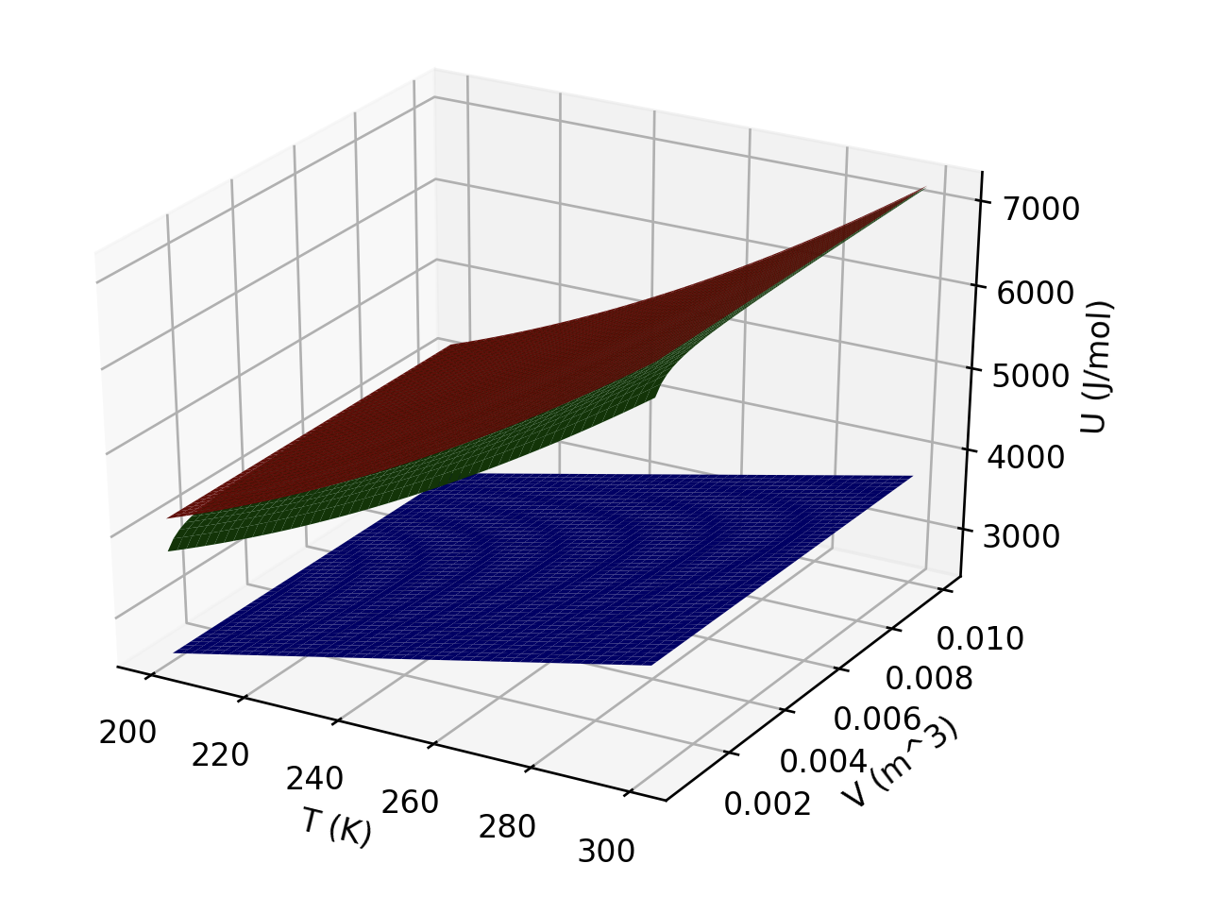
Week 4
Interpreting U(T,V)
What is responsible for the curvature of the red and green gases (in the temperature direction)?
Which gas(es) could be ideal?
Which is probably a monatomic gas?

Slide 17
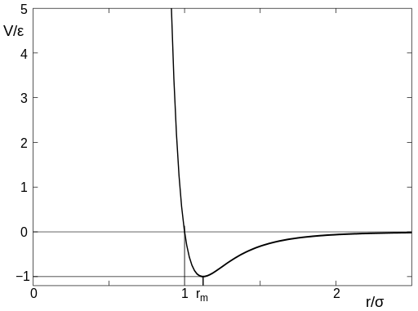
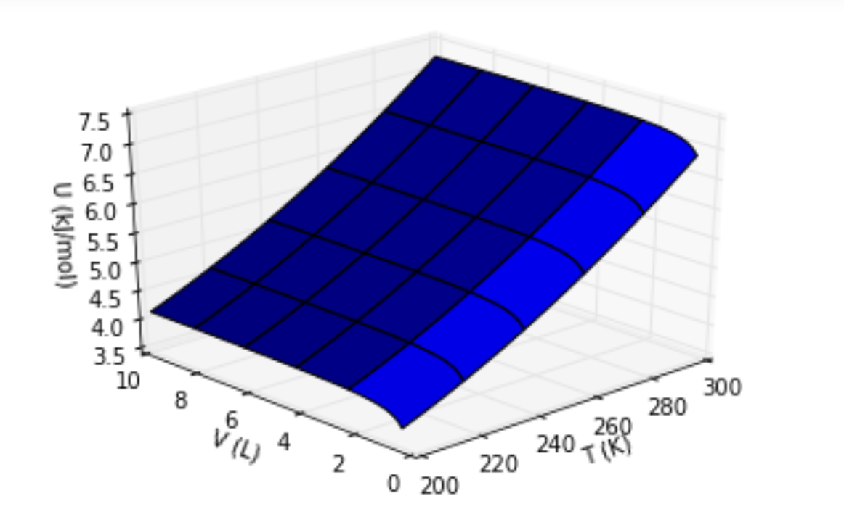

Week 4
Intermolecular potential energy
Describe the meaning of ‘d’ in the figure on the left
Describe what feature of the figure on the right is explained by the figure on the left
Intermolecular potential energy
d

Slide 18
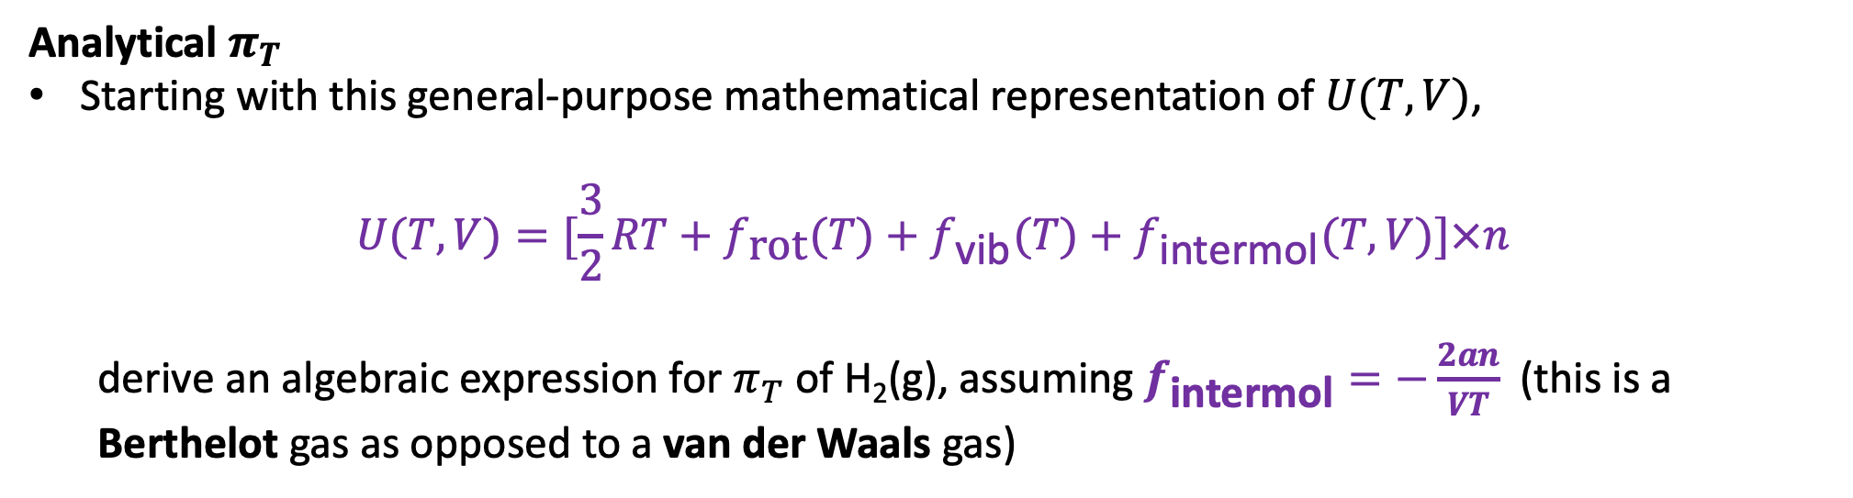
Week 4
Analytical $π_{T}$
Starting with this general-purpose mathematical representation of $U(T,V)$,
$$U(T,V)=[\frac{3}{2}RT+f_{\text{rot}}(T)+f_{\text{vib}}(T)+f_{\text{intermol}}(T,V)]×n$$
derive an algebraic expression for $π_{T}$ of H₂(g), assuming $f_{\text{intermol}}=−\frac{2an}{VT}$ (this is a Berthelot gas as opposed to a van der Waals gas)

Slide 19
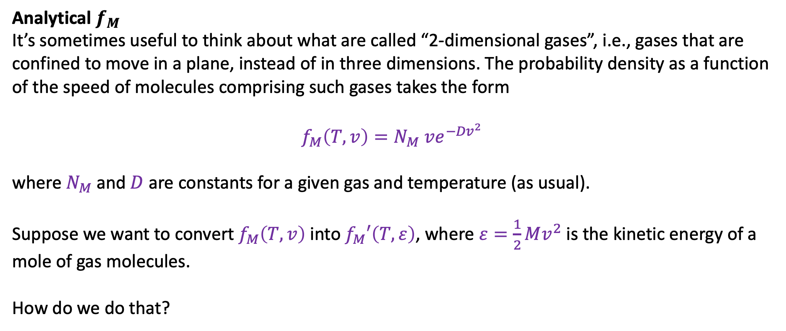
Week 4
Analytical $f_{M}$
It’s sometimes useful to think about what are called “2-dimensional gases”, i.e., gases that are confined to move in a plane, instead of in three dimensions. The probability density as a function of the speed of molecules comprising such gases takes the form
$$f_{M}\left(T,v\right)=N_{M} ve^{−{Dv}^{2}}$$
where $N_{M}$and $D$ are constants for a given gas and temperature (as usual).
Suppose we want to convert $f_{M}\left(T,v\right)$ into $f_{M}′\left(T,ε\right)$, where $ε=\frac{1}{2}Mv^{2}$ is the kinetic energy of a mole of gas molecules.
How do we do that?

